Slide 1

Data Exploration & Preparation Assignment
Name : ………………………………………………….

Slide 2
AI Eagles
Who are we?
AI Eagles is a startup for building intelligent solutions using Artificial Intelligence, Machine Learning, Deep Learning for Applications in Data Analysis, Data Science, Computer Vision and NLP.
What do we aim for?
AI Eagles offers many services, in general we transform your work into intelligent solutions starting from Data Analysis/Science till building complex Models for Computer Vision and NLP.
AI Eagles also offers an AI professional Diploma for student or companies starting from scratch till be a Machine Learning Engineer or Data Analyst or Data Scientist.

Slide 3
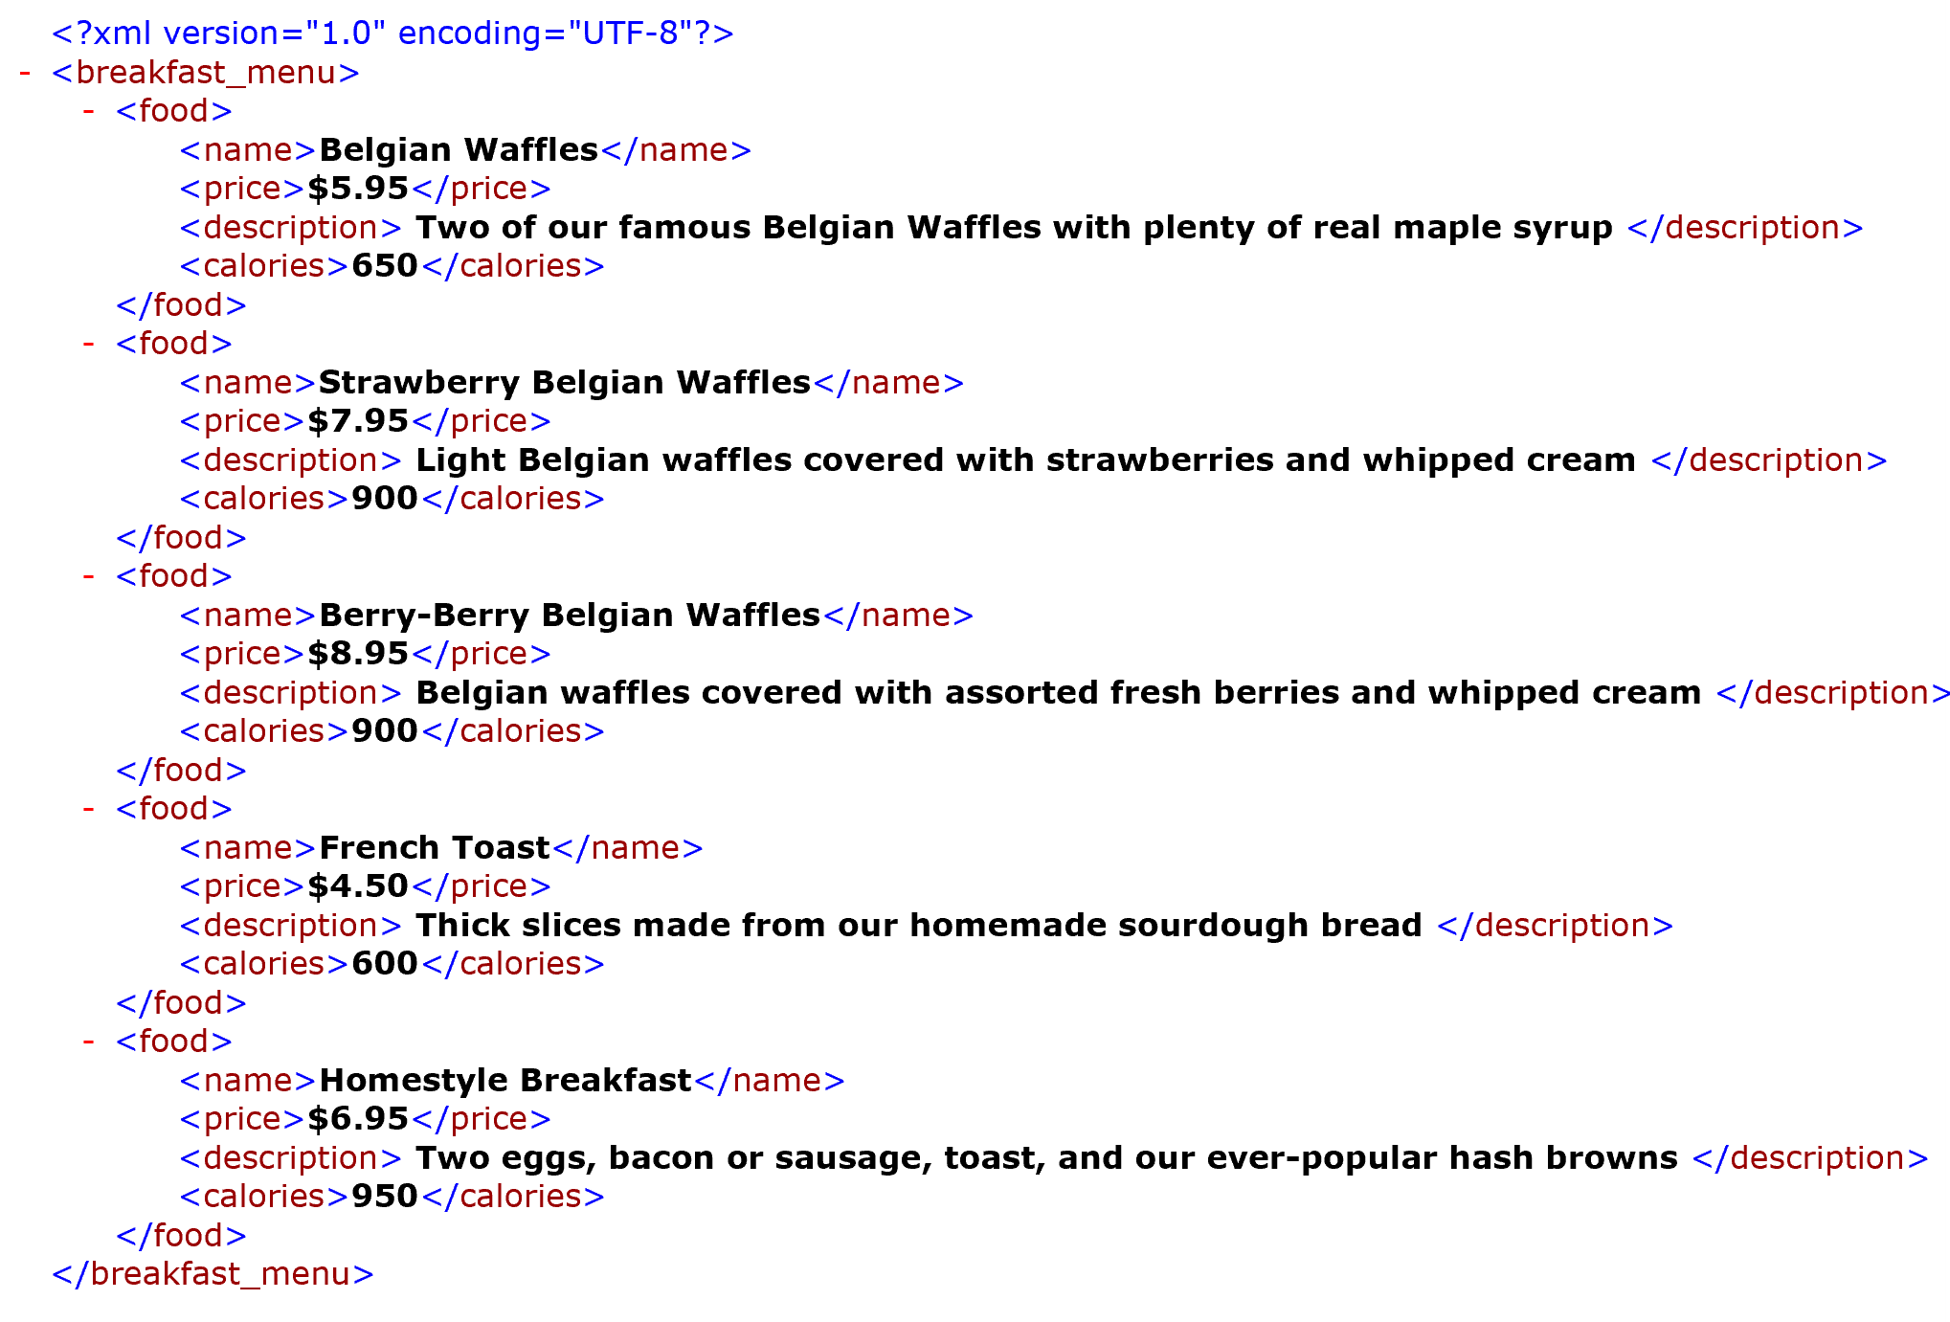
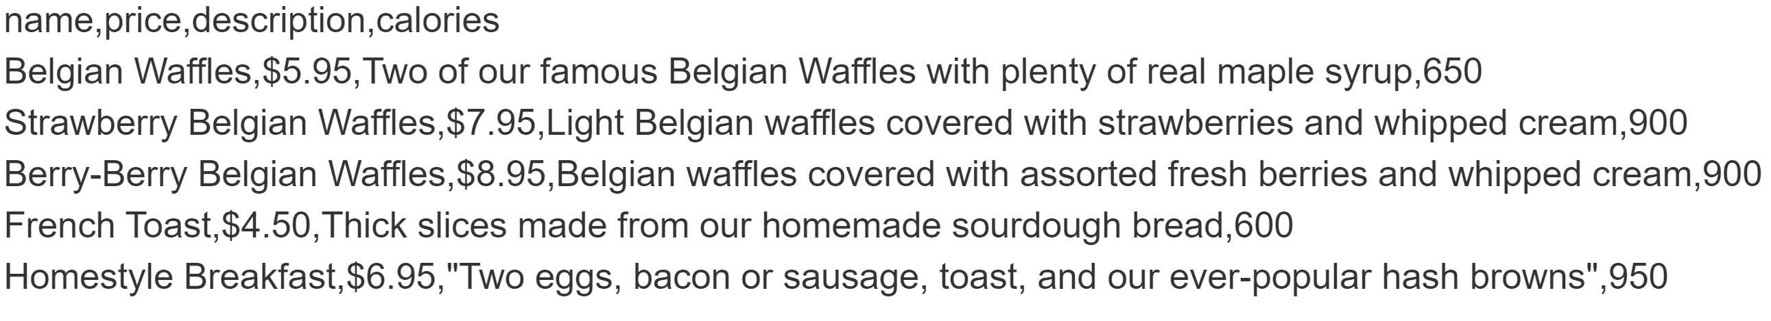
How did you do the conversion? Ex. Python [share code], used online parser[add URL], other parser tool [mention name]
XML to CSV
Please include similar snapshots
Used tool: …..
XML
CSV

Slide 4
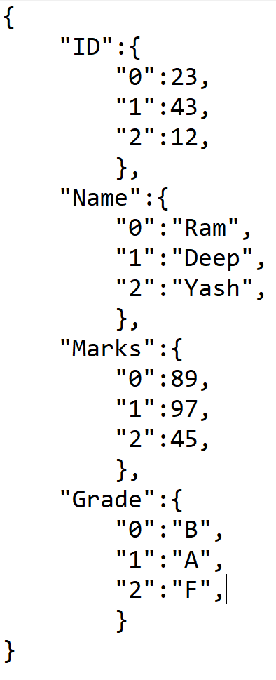
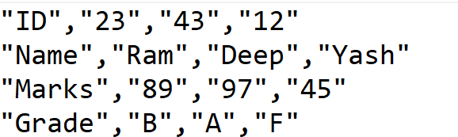
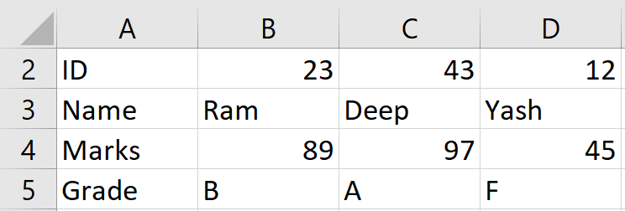
How did you do the conversion? Ex. Python [share code], used online parser[add URL], other parser tool [mention name]
JSON to CSV
Please include similar snapshots
Used tool: …..
Additional: Validate it is opened through excel
CSV
XML

Slide 5
ARFF to CSV
Used tool: …..
ARFF
CSV

Slide 6
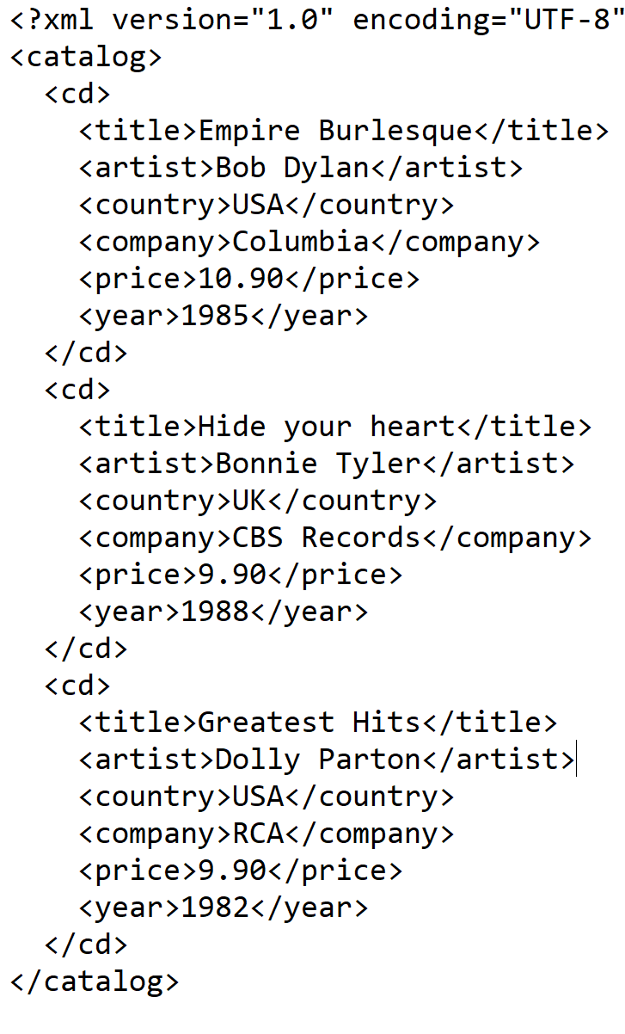
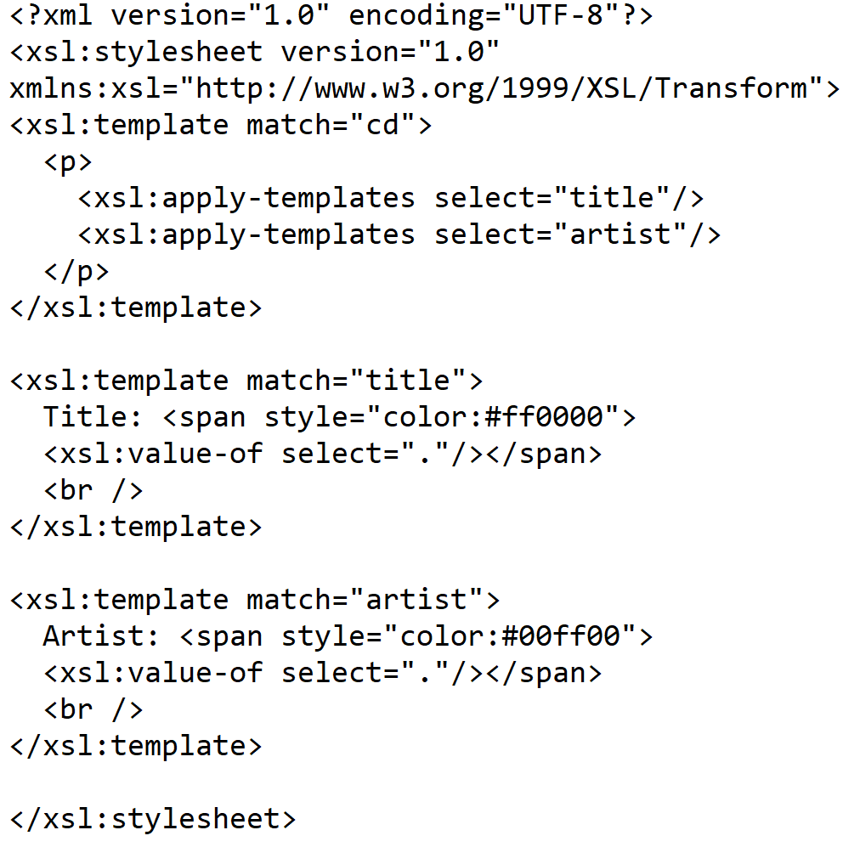
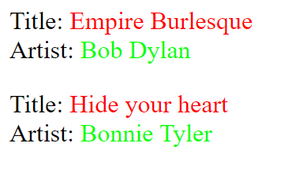
XSLT
Used tool for conversion: …..
XML
XSLT
Formatted output

Slide 7


